Slide 1
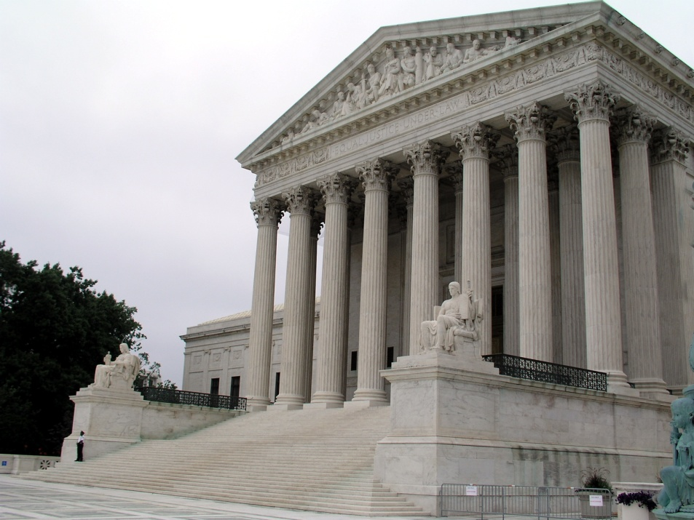
Roe v. Wade (1973)
Legalized abortion in the United States

Slide 2
Each and every human life is valuable
from the moment of conception.
We are all responsible for
building a culture of life.

Slide 3
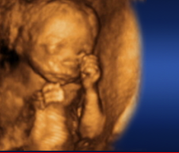
Facts about the Preborn
From the moment of conception, all 46 chromosomes are present, gender is determined, and a new unrepeatable human being comes into the world.
By the third week, the heart begins to beat.
Brain waves can be recorded in the second month.
By eight weeks, all body systems are present.
Notes:
Review of basic fetal development facts
Watch Me Grow, Little One Sweet Publishing (2004).
http://babystepsdvd.com/

Slide 4
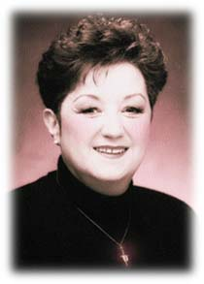
Facts about Roe
Roe v. Wade legalized the killing of the unborn in the United States at any time for any reason.
Since Roe v. Wade, roughly 50 million unborn Americans have been killed and their parents forever harmed. That decision and its ramifications are part of the culture of death.
Alan Guttmacher Institute, Facts on Induced Abortion in the United States.
Norma McCorvey, “Roe,” now regrets
her involvement in the case.
Notes:
In the decade before Roe, a few state legislatures began passing laws legalizing abortion in limited circumstances.
Roe v. Wade (1973)
With this decision and its companion case, the Supreme Court found a right to privacy in the Constitution that includes a right to abortion at any stage in pregnancy for essentially any reason whatsoever.
First, the Court limited this right, allowing states to put certain restrictions on abortion, to protect the health of the woman and to protect the life of the unborn. According to the Court, the state has the right to regulate or proscribe abortion “except where it is necessary, in appropriate medical judgment, for the preservation of the life or health of the mother.
Then the Court so broadly defined “health” to functionally defeat this limitation. Health is defined in Roe’s companion case, Doe v. Bolton to be “that the medical judgment may be exercised in the light of all factors - physical, emotional, psychological, familial, and the woman's age - relevant to the wellbeing of the patient. All these factors may relate to health. This allows the attending physician the room he needs to make his best medical judgment.”
The result – by Court order, abortion is legal through all nine months of pregnancy, for virtually any reason.
1 minute video of Norma McCorvey, Roe in Roe v. Wade, describing how she has since come to regret her involvement in the case: http://www.youtube.com/watch?v=T_MUUvcvjEg
Subsequent developments
Over the last 35 years, courts and legislatures have wrestled with various protections for women and the unborn, including fetal pain legislation, restrictions on certain types of abortions, requirements of notification to a minor’s parents before abortion, requirements that certain information be provided to a woman seeking an abortion, and others.
Roe v. Wade, 410 U.S. 152-3 (1973).
Roe v. Wade, 410 U.S. 162-4 (1973).
Roe v. Wade, 410 U.S. 164-5 (1973).
Doe v. Bolton, 410 U.S. 179, 192 (1973).
http://www.youtube.com/watch?v=T_MUUvcvjEg

Slide 5
Roe v. Wade (1973)
A right to abortion at
any stage in pregnancy
for essentially
any reason.

Slide 6

Roe’s Effects
There have been more than 52 million abortions since 1973.
For every 1,000 live births, there were 236 abortions in 2006.
There were over 3,300 abortions per day, 137 per hour, about one every 30 seconds in 2005.
Every year, the number of children who die from abortion is roughly equal to the number of Americans who die in the Revolutionary War, the Civil War, World Wars I and II, the Korean, Vietnam and Gulf Wars combined.
National Right to Life, The Basics: A compilation of recent and noteworthy information about the abortion issue.
Notes:
New methods of abortion have been created that further deny the humanity of the unborn, including the morning after pill, RU-486, and abortifacient contraceptives. All of these are legal and end the life of a human being. Most are marketed as contraception.
Some scientists have discovered that the unborn feel pain. At 5 weeks, pain receptors are found around the mouth. By 18 weeks, they are present throughout the body.
National Right to Life, Pain of the Unborn, http://www.nrlc.org/abortion/Fetal_Pain/FetalPain091604.pdf.
Facts based on 2006 statistics (which should be roughly accurate today)
There have been more than 52 million abortions since 1973.
There were over 1.2 million abortions in 2005.
There were over 3,300 abortions per day, 137 per hour, about one every 30 seconds in 2005.
For every 1,000 live births, there were 236 abortions in 2006.
There were more than 95,000 second and third trimester abortions in 2006.
The number of children aborted each year nearly equals the number of Americans deaths in the Revolutionary War, the Civil War, World Wars I and II, the Korean, Vietnam, and Persian Gulf Wars combined.
Less than 4% of abortions are committed in cases of rape and incest.
National Right to Life, The Basics: A compilation of recent and noteworthy information on the abortion issue, http://www.nrlc.org/Factsheets/FS09_TheBasics.pdf.
National Right to Life, The Basics: A compilation of recent and noteworthy information on the abortion issue, http://www.nrlc.org/Factsheets/FS09_TheBasics.pdf.
40 second pro-life advertisement video, “Imagine the Potential”: http://www.catholicvote.org/index.php?/site/viewVideo/&videoId=V2CaBR3z85c
National Right to Life, Why to Women Have Abortions?, http://www.nrlc.org/ABORTION/facts/reasonsabortions.html.

Slide 7

Planned Parenthood
Over one million abortions are performed every year across the country.
More than ¼ of these are provided by Planned Parenthood, the nation’s largest abortion provider.
While dropping in the U.S. as a whole, abortions performed at PPFA clinics during the same time frame (1990-2009) have increased by 251%!
Notes:
Well over one million abortions are performed each year across the country. Millions more are committed throughout the world.
Planned Parenthood
Nation’s largest abortion provider, providing 24% of abortions in the United States in 2006
Margaret Sanger, foundress of Planned Parenthood
"More children from the fit, less from the unfit -- that is the chief aim of birth control."
National Right to Life, Planned Parenthood, http://www.nrlc.org/Factsheets/PPabortionFSrev.pdf.
Birth Control Review, May 1919, p. 12

Slide 8

Effects on Women and Families
43% of women will have at least 1 abortion by the age of 45.
70% of women choosing abortion believe that abortion is morally wrong. They are choosing against their consciences because of some pressure, from others or
circumstances, which make
them feel they have no other
choice.
The Jericho Plan: Breaking Down the Walls Which Prevent
Post-Abortion Healing, by David C. Reardon. Springfield,
IL: Acorn Books, 1996
Notes:
http://www.rachelsvineyard.org/video/index.aspx
½ of all abortions are committed on women under 25 years old
43% of women will have at least 1 abortion by the age of 45
70% of women choosing abortion believe that abortion is morally wrong. They are choosing against their consciences because of some pressure, from others or circumstances, which make them feel they have no other choice
Symptoms of post-abortion stress include:
Bouts of crying
Depression
Guilt
Inability to forgive oneself
Intense grief / sadness
Anger / rage
Emotional numbness
Sexual problems or promiscuity
Eating disorders
Lowered self esteem
Drug and alcohol abuse
Nightmares and sleep disturbances
Suicidal urges
Difficulty with relationships
Difficulty bonding with subsequent children
Anxiety and panic attacks
Flashbacks
Multiple abortions
Pattern of repeat crisis pregnancy
Discomfort around babies or pregnant women
Fear / ambivalence of pregnancy
Watching their parents experience these symptoms affect parents’ born children as well.
4 ½ or 7 minute Rachel’s Vineyard video: http://www.rachelsvineyard.org/video/index.aspx. Scroll down to “How to Save a Life.” If you are running low on time, stop the video after the first song. The second plays during testimonies of post-abortion healing.
Alan Guttmacher Institute, Facts on Induced Abortion in the United States, http://www.guttmacher.org/pubs/fb_induced_abortion.html.
The Jericho Plan: Breaking Down the Walls Which Prevent Post-Abortion Healing, by David C. Reardon. Springfield, IL: Acorn Books, 1996
The Jericho Plan: Breaking Down the Walls Which Prevent Post-Abortion Healing, by David C. Reardon. Springfield, IL: Acorn Books, 1996

Slide 9
Each and every human life is valuable
from the moment of conception.
We are all responsible for
building a culture of life.
Notes:
Brainstorm 3 ways in which you personally have been affected by Roe v. Wade and 3 ways you can respond, building a culture of life.
Invite students to share with the class if they wish.

